Slide 1

How do I find the first RPA robot?
Workshop
David.Wright@Kofax.com
Partner Development Manager
Notes:
Winning the Customer in the Cognitive/AI/RPA World.
Session Goals :Understand and articulate the value of focusing on human performance rather than machine performance in RPA & CDA opportunities.
Various Case Studies to make the problem very clear.

Slide 2

Notes:
Is your understanding of RPA stuck in the 1980’s with robots coming to take your job?
The Terminator movies of 1984 and 1991 personified the risk of AI as terminator robots intent on killing humans, so the humans rebelled. The “AI Skynet” they were talking about then was actually just a database: the SQL database was entering into the business world – data was being digitized. No-one fears a database today more than 30 years later. The AI fears of today will not concern our children.

Slide 3


Notes:
RPA is really about enhancing not replacing human performance. Do not try to remove people. You want people to do smart, creative tasks in a process. Only automate what a human doesn’t want to do.
This photo is part of a series about robots and humans interacting – but this photo is special, because the robot is working for the human in a passive way. The human is in full control – this is Kofax’ model of human-robot cooperation.
This image is common on the internet.
It can be found here https://www.gettyimages.at/detail/foto/robot-and-businesswoman-using-computer-stock-fotografie/529301356
The earliest reference I find of it is http://carlibux.blogspot.com/2010/12/human-vs-robot.html. There is a question from me 6 Sep, 2013 asking for the owner, with no reply.

Slide 4
The three steps of a robot
GET CHANGE PUT

Slide 5
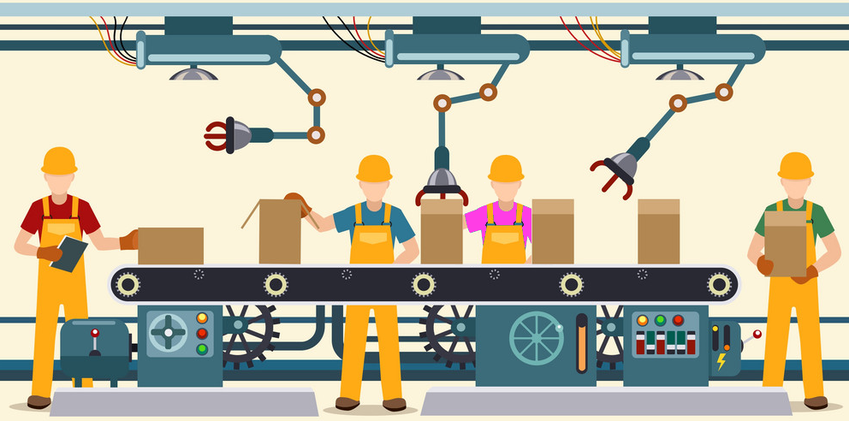
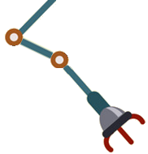



Robotic Process Automation
360
400
320
300
380
320
390
290
305
360
400
4000
400
Notes:
Add 3 robots. 4 people can now process 300 boxes. This is robotic process automation. The humans are assisted by robots.
It doesn’t make sense to say that 3 robots process 100 boxes. It doesn’t actually matter what the robots do. It makes sense that the people process 400 boxes with the help of robots.
If robot#2 can shut 200 boxes does that actually mean anything?
The value of the 3 robots is +100 boxes or +33%. By measuring the humans we know the PRECISE VALUE of the robots, and can calculate accurately the ROI of the robots.
But it gets better. We can ask the question “How do we get better than 300 boxes?”
Now we are open to many choices. We can score them all on human improvement and then implement the solution that gives the most value.
Add another robot
Make blue and purple person swap place.
Give green a table.
Red should stop using a clipboard.

Slide 6
RPA Market

Slide 7
Which Finance processes are suitable to deploy with RPA?
Transaction processing
External reporting
Record to report (general accounting)
Purchase to payment
Order to cash
General Ledger
Accounting
Consolidations
Monthly/ Quarterly Close
Financial Reconciliation
Requisition Materials
Purchasing/ Procurement
Order Entry
Billing
Legal Entity Reporting
Statutory Reporting
Fixed Asset Accounting
Tax Planning/ Accounting
Benefits Admin./ Accounting
Inquiry Handling
Payment Processing
Accounts Payable
Cash Application
Collections
Regulatory Reporting
Rating Agency Relations
Premium Accounting (Ins)
Re-insurance Accounting (Ins)
Investment Accounting/ Securities Pricing (FS)
Daily P&L/ Mark to Market/ Middle Office
T&E
Accounting/ Reimburse-ment
Procurement. Card Admin
Bank Reconciliation
Treasury/ Trust Management
Investor Relations
Business decision support
Finance management
Planning
Control
Strategic Planning
Budgeting & Financial Planning
Forecasting
Accounting/ Tax Policy
Internal Audit
Financial Analysis
Internal Consulting
Project Management
Finance Function Management
Human Performance Management
Business Liaison
Training & Development
Management reporting
Specialized expertise
Expense/ Revenue Allocations
Performance Measure-ments
Multi-Dimensional Reporting
Profit Center/ Customer/ Producer Profitability
Acquisitions & Divestitures
Risk Management (CM)
Actuarial Analysis/ Reserving (Ins)
Real Estate Mgmt.
Opportunities for Automation
Low
Medium
High

Slide 8
Which HR processes are suitable to deploy with RPA?
Shared Services typically offer a good range for automation solutions
Talents
HR Operations & Support
HR Strategy
HR Steering
Talent
Customer Services
Documents Mgmt.
Human Capital Strategy
Strategic Workforce Planning
Governance
Organizational Design
Competency Framework
Contact / Inquiry
Portal/ Knowledge Mgmt.
Physical Records
Document Management
HR Strategy
Metrics & Analytics
Employer Branding
HR Services & Administration
Employee Services
Talent Life-Cycle
Employee Relations
Discipline & Grievance
Mobility Services
Leave Management
Sourcing
Deployment
Performance
HR Development
Rewards
Talent Sourcing
Workforce Planning
Competency Management
Compensation
Absence Management
Health & Safety
Exit Management
Labor Relations
Executive Development
Recruiting
Career Pathing
Objective Setting
Learning
Benefits
Payroll and Administration
Master Data Management
Compensation Admin.
Pension Administration
Transfers
Succession Planning
Performance Management
Knowledge Management
Pensions
Organizational Design
Benefits Administration
HR Payroll
Contingent Staffing
Workforce Scheduling
Performance Support
Recognition
Opportunities for Automation
Low
Medium
High

Slide 9
Which Supply Chain processes are suitable to deploy with RPA?
Plan
Source
Deliver
Perform Demand Planning
Perform Sourcing Strategy
Operational Procurement
Process Orders
Manage Transportation
Enterprise Forecasting
Demand Sensing
Define Sourcing Strategy by Commodity
Conduct RFx/Auctions and Optimize Bid
Create Requisition and Obtain Approval
Transfer Product
Process Inquiry and Quote
Release and Consolidate Orders
Build Loads
Deliver Product to Customer
Customer Collaboration
Analyze Supply and Assess Opportunity
Negotiate Contract
Create Purchase Order
Asses Impact of Product
Receive, Enter & Validate Order
Generate Invoice and Collect Payment
Route Shipments
Manage Import/Export and Customers
Perform Integrated Business Planning (Sales & Operations Planning)
Analyze Supply Market and Qualify Suppliers
Select and Activate Supplier
Receive and Verify Product
Authorize Supplier Payment
Check for Inventory Availability
Process Complaints and Inquiries
Select, Rate and Schedule Shipments
Manage Transportation Assets
New Product Development
Conduct Financial Reconciliation
Reserve Inventory & Determine Delivery Date
Load Vehicle and Generate Shipping Docs
Manage Freight Pay and Audit Process
Perform Sourcing Strategy
Segment Suppliers
Measure and Drive Performance
Conduct Supplier Reviews
Terminate / Transition Suppliers
Conduct Supply Balancing
Manage Warehousing
Process Returns
Terminate / Transition Suppliers
Track Continuous Improvement
Receive Product from Source (Supplier)
Pick Product
Perform Returns Planning
Execute Processing of Returns, Repairs and Recalls
Perform Inventory Planning
Track Product Lots and Batches
Plan and Manage Inventory
Manage Contracts
Pack and Label Shipment
Manage Warehouse Operations
Manage Returns Policies and Procedures
Create Contract
Monitor and Enforce Contracts
Perform Inventory Control
Opportunities for Automation
Low
Medium
High

Slide 10
Measuring

Slide 11


RPA Prioritization Matrix
Low Complexity High Benefits
Quick ROI
High Complexity High Benefits
Consider Process Optimization
1. Quick wins
2. Too complex, break it down
Value/Benefits/ROI
Low Complexity Low Benefits
Do when project cost is lower
High Complexity
Low Benefits
Poor ROI
3. Do it much later
4. Requires human cognition
Complexity Low (routine, automatable) →High (difficult, exception, need humans)

Slide 12
Value/Benefits
Human
Minutes/day, minutes/role, people/day (FTE), role/day
Number/day
Minutes/person, increase human capacity
(Response/Elapsed) time/customer
Staff health/happiness/turnover
Business
Dollars/day
Mistakes/case
Penalties/avoided
Customers won/lost/complaints/delay
Days Sales Outstanding (DSO)
IT
Serverload saved
3rd party licenses saved

Slide 13
ROI
Don’t calculate ROI just on one or two use cases.
How many uses cases do they plan to have over two years.
Focus on human metrics

Slide 14
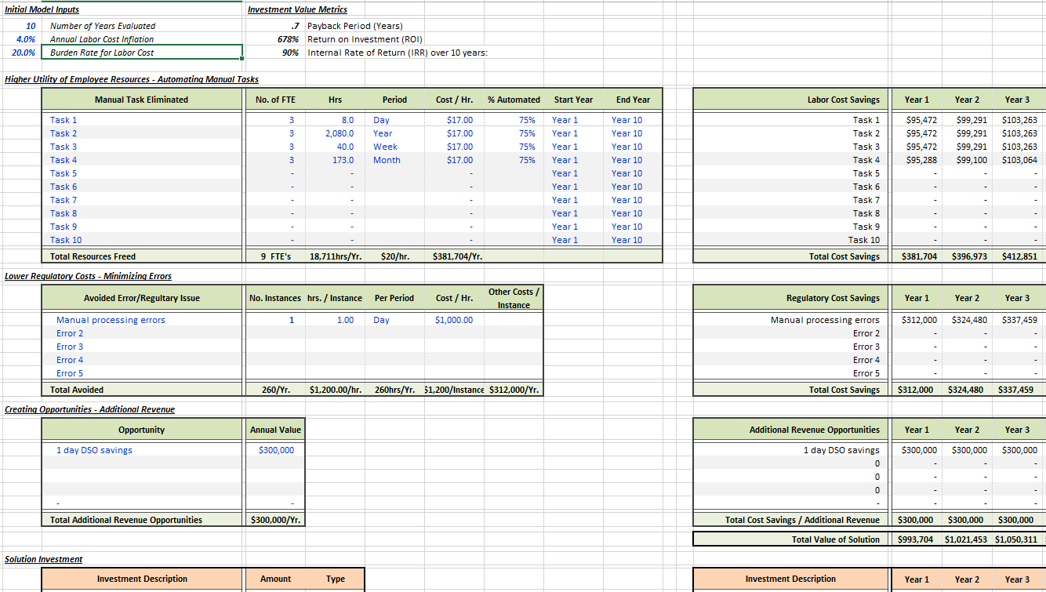
ROI Calculations

Slide 15
Team Work

Slide 16
Team Work
Sales
Don’t assume you know what the customer needs.
Understand the customer and listen. Get into their mind.
Analyse their business problems, don’t offer a presumed technical solution
Sales Engineering
Demos? No Demos? Proof of concept.
Tell STORIES from a user’s perspective, solve business problems, no tech focus
Your goal is to close a deal, not show stuff or impress.
Be a trusted advisor, instil confidence with competence
Drive everything back to the business needs, don’t get lost in the tech

Slide 17
Team Work 2
Professional Services
When to bring in the sales process? implementation/coaches.
Build Robotic Competence Center.
Education
Product knowledge.
Technical Support
Problem reporting. How To?
Customer Care
Health Check, Expansion. Who is doing this?

Slide 18
Robotic Competence Center
Notes:
How to build a robotic competence center in your organization. Which people and roles do you need? What is the recipe for success?

Slide 19
Land & Expand
Land by demonstrating value to all stakeholders
Expand by building a compentance center
Continuous improvement

Slide 20
An Example Implementation plan
Kick off
Charter
Product training
Product training delivered by Kofax Professional Services / Education Services
Setting expectations & goals for Customer and Kofax
Methodology
Planning/timebox
Source control
Agile Delivery
Define, prioritize and add robot use cases to backlog and deliver in timeboxes
Continuous Improvement
Technical architect and business consultant support
2x 3-week-timeboxes, staffed by Kofax Professional Services
2x 3-week-timeboxes, transition fully to Customer
CC Best Practices
Roles, processes & governance
Recommendations for optimal scalability and throughput
Architecture review
Assist Customer with foundation and start building robots with the Customer team
Demonstrate
4 day classroom + 1 day to review use cases and start building a first robot
Healthcheck
Demonstrate value to all stakeholders
2x 3-week-timeboxes, Customer resources start with active shadowing in pairs

Slide 21
Use case analysis
Quickscan using Scorecard
Repetitive
High volume
Structured
Rule driven
Limited exceptions
Review AS-IS use case business process with end users and record on video
Frequency
SLAs
FTEs
Assess applications in use on automation complexity
Web applications
Thick clients
Terminal applications
ROI calculation

Slide 22
Competence Center Process
Owner: Business
Case Reviewed
Owner: Member of competence center
Build
Owner: Competence Center Team
Captured in documents, diagrams and video
Accept/reject, Priority decided, clarification from the business if required, time allocation/budget
Build, Test and deploy use case
Support: Kofax Professional Services
Robotics use case initialized
Support: Kofax Business Analyst

Slide 23
Competence Center Team Roles
Ambassador/Evangelist/Champion per business line (HR, Finance, Logistics, Know Your Customer)
Robot user/authentication specialist
Business Analysts
Robot Builders
IT team
Librarian
Technical Architect

Slide 24
IT Roles in Kofax RPA
Server/VM Hosting
Database Management
Backup
Performance, Indexing, Link Servers
User Management
Views
Security
User Access
Regular SQL Exports from Business Systems.

Slide 25
Process Analysis

Slide 26
Process Analysis Best Practices
Tools
Visio, Notepad, CaseWise, Avis, OneNote, PowerPoint?, Excel, Pencil & Paper, Word, Mindmap
Understand the current process
Interview users. Make them feel heard. Capture their screens. Ask Why 5 times until you get to the root causes.
Describe the process flow
Validate with users
Redesign/reengineer/reassess the process
Optimize process logic – robots think differently than humans.
Reduce latency – reduce time people have to wait for task to complete
Improve frequency – run the robot as often as possible

Slide 27
Use Case : Closing Opportunities in Kofax Sales
Would it be possible to do 3 different scenarios?
There is a Bill To ID that starts with 00002 with no email address – In that case we would need to have the rep create a new bill to WITH an email address. Here is an example of the opp: https://lexmark.my.salesforce.com/0063100000Yuty5#img_01Bi000000B79nM We would need the robot to click on the ‘Click here to edit’ next to the ‘Bill To’ then click ‘Request New Bill To’ and enter the address information, email address, and primary language
There is a Bill to ID that does not start with 00002 with no email address – In that case we would need to have the rep request a modification of the bill to with an email address. Here is an example of an opp: https://lexmark.my.salesforce.com/006i000000TjBn6 We would need to robot to click on the ‘Click here to edit’ next to the ‘Bill To’ then check the ‘Select’ box of the existing bill to, then click ‘Request Modification to Bill To’ and then the rep would need to enter the email address
There is no Bill to ID (which means there is no email address either) – In that case we would want to link the rep to the ‘Click here to edit’ next to the ‘Bill to’ and remind them that they need to select a bill to with an email address. Here is an example of an opp: https://lexmark.my.salesforce.com/006i000000PI1Gd
Notes:
This is the logic that a person uses to solve a business problem. This logic needed unravelling. It seems logical and simple to a person but it is not useful for a robot – see the next slide on how to “robotize” this process.

Slide 28
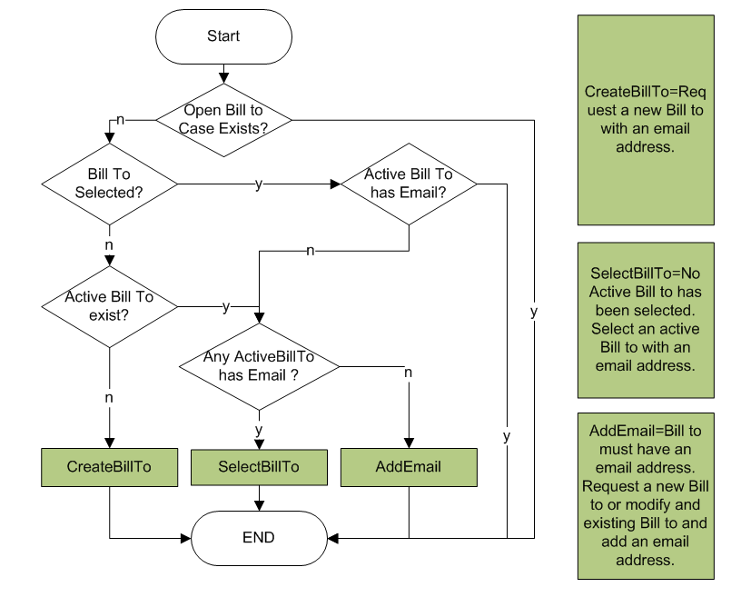
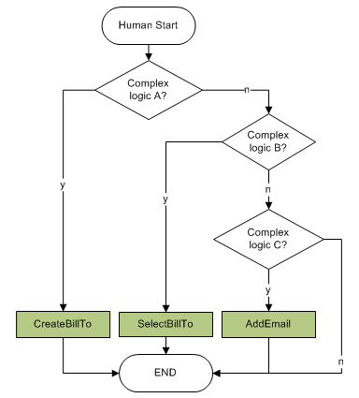
Use Case : Closing Opportunities in Kofax Sales
Robot starts here. More clicks.
Simple logic.
6 logic paths.
“Yes” branch exists fast.
Human starts here.
Less clicks. complex logic.
“3 scenarios”
Notes:
The human had three decisions to make (see right flow diagram), but each decision was complex. After analysis their were really 5 simple decisions to make and the robot makes them in a different order than the human.

Slide 29
Kofax Positioning

Slide 30
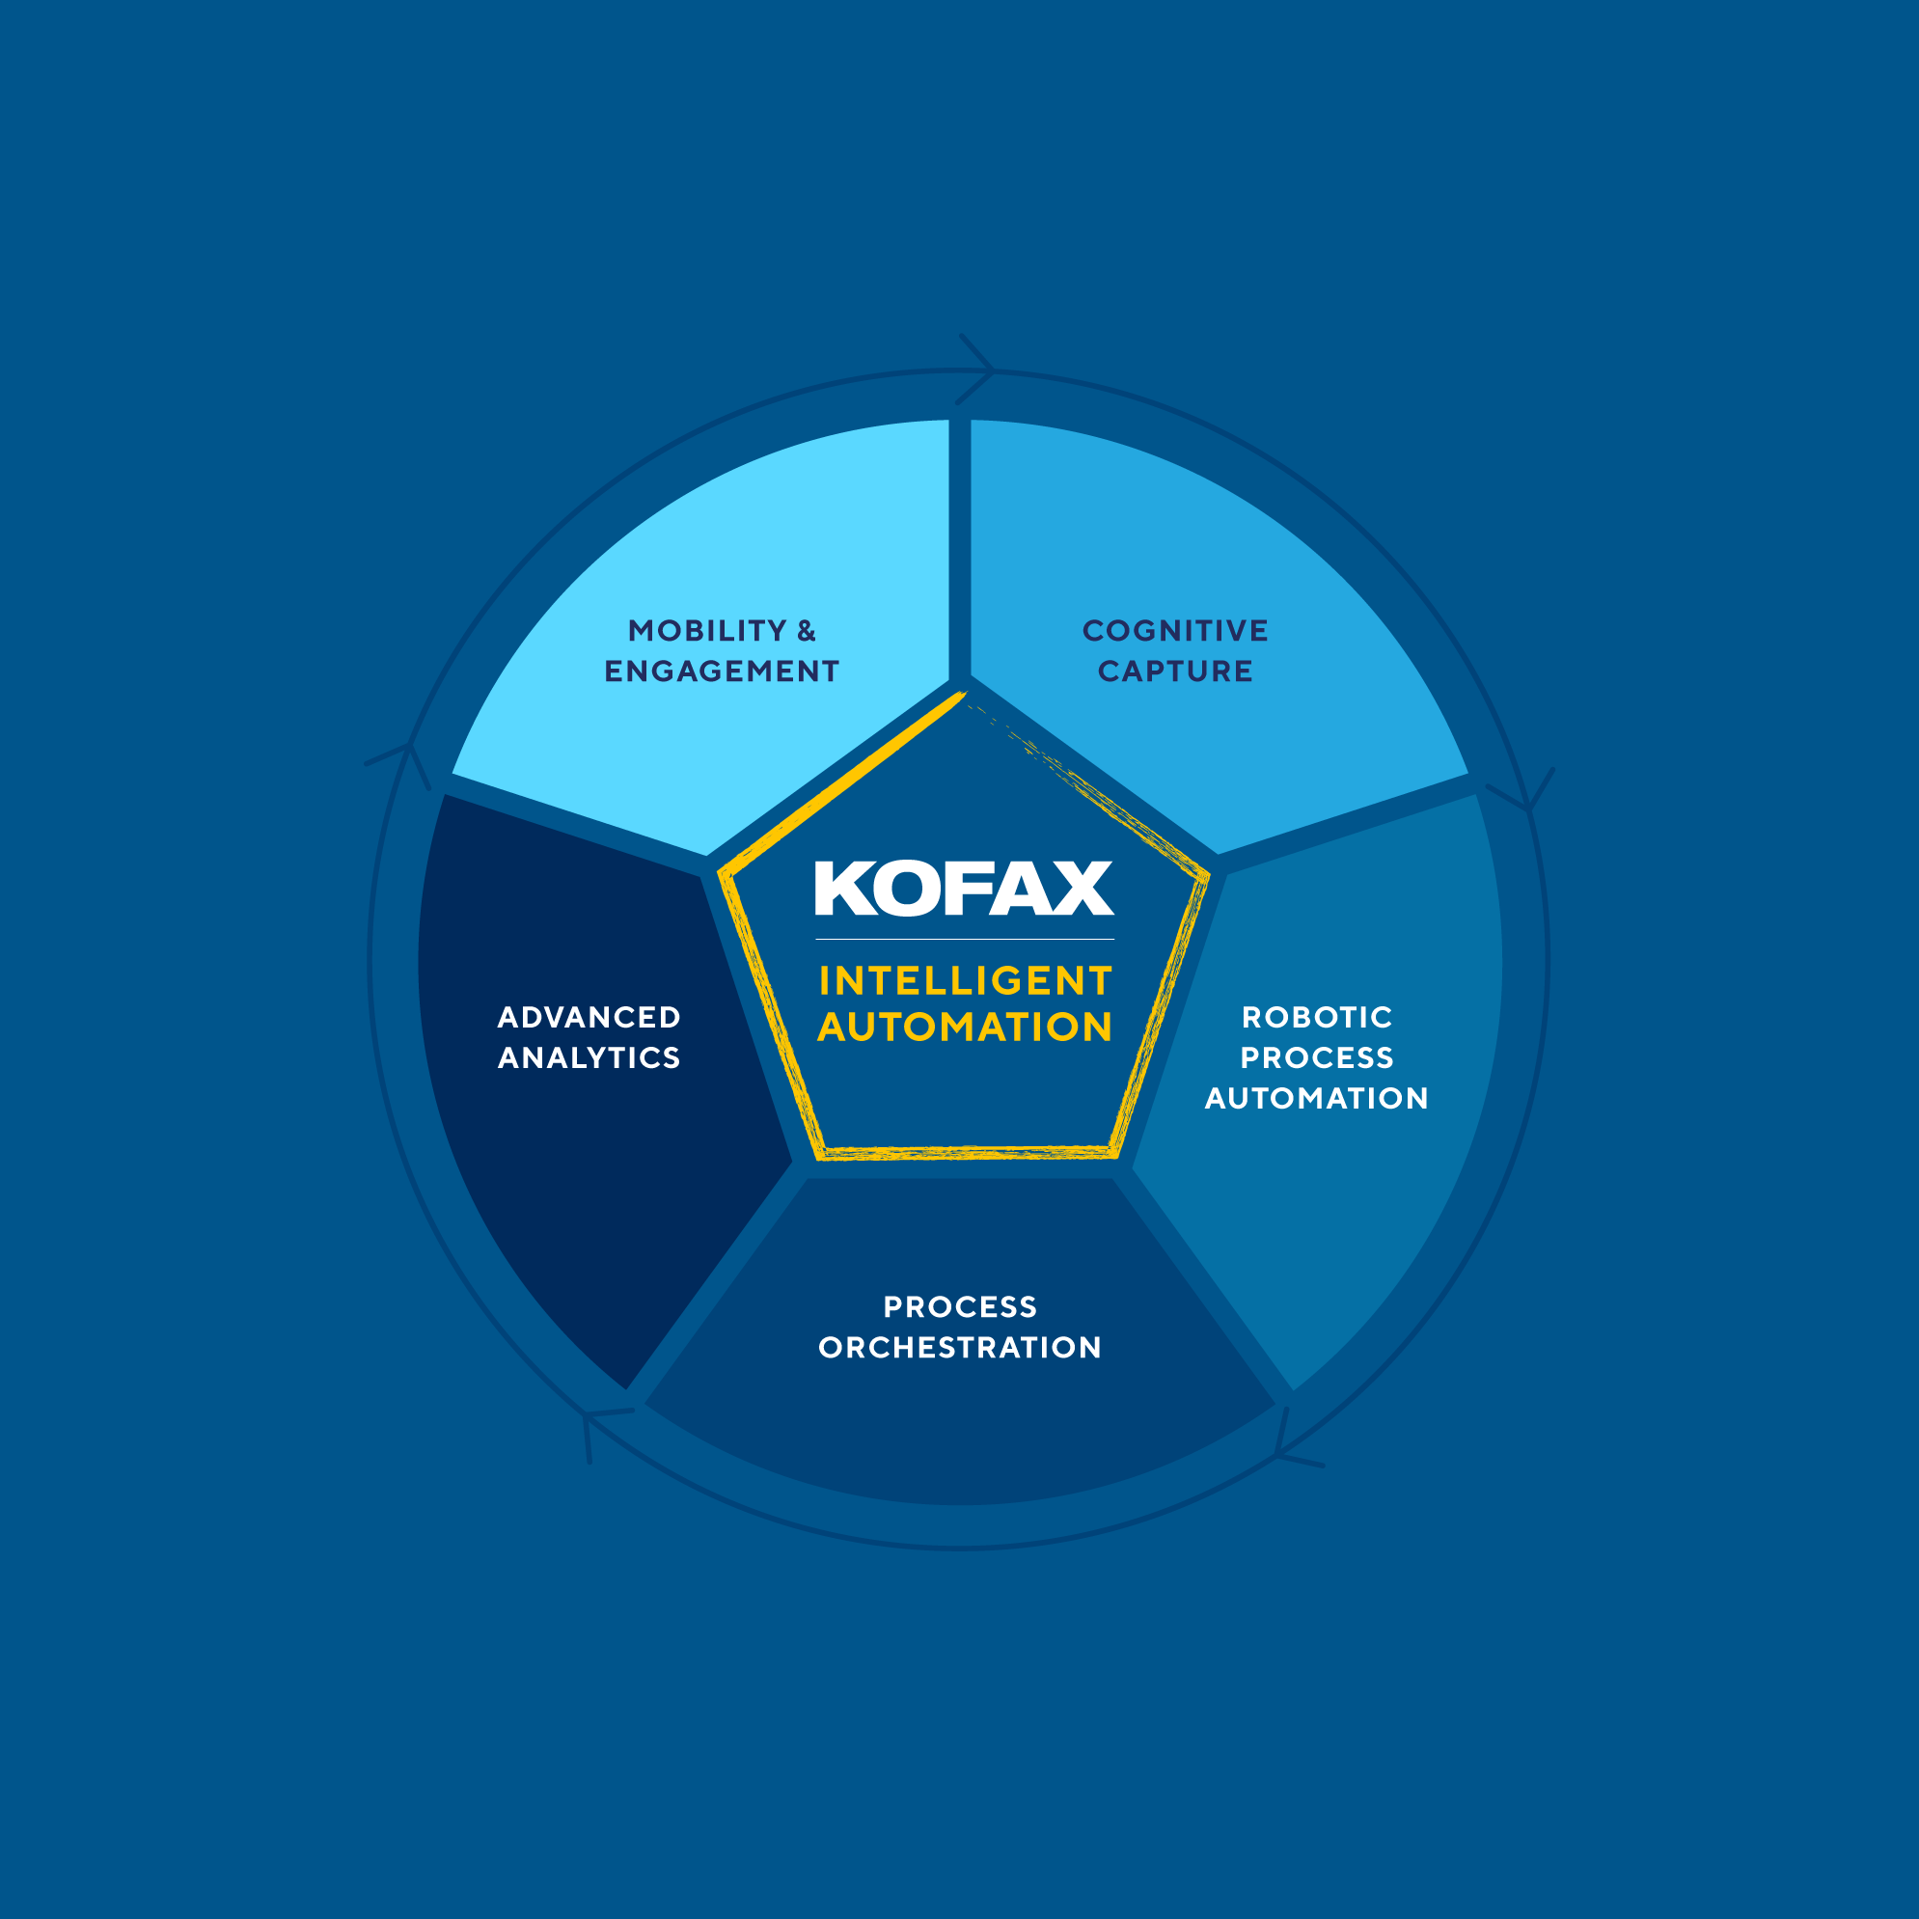
Kofax Intelligent Automation – Five unified capabilities
MOBILITY & ENGAGEMENT
Communicate and transact in efficient, effective, and trusted ways with e-signature, facial recognition and on-demand communications
COGNITIVE CAPTURE
Ingest & understand any document and its information via any ingestion channel and in any format with capture and cognitive document automation
ROBOTIC PROCESS AUTOMATION
Automate repetitive tasks with a digital workforce of attended and unattended software robots
PROCESS ORCHESTRATION
Drive successful outcomes by orchestrating multiple actions, people, software robots, policies & systems
ADVANCED ANALYTICS
Provide actionable analytics for any business process with increased visibility and deeper insights
Notes:
Each of the 5 capabilities of the Kofax Intelligent Automation platform are summarized here.
[read round if needed]
I want to emphasis that an additional capability of the platform is that we have invested to ensure that these capabilities work well together – that’s what we mean by “unified”.
You need these capabilities to be unified, so we’ve done this on your behalf.

Slide 31


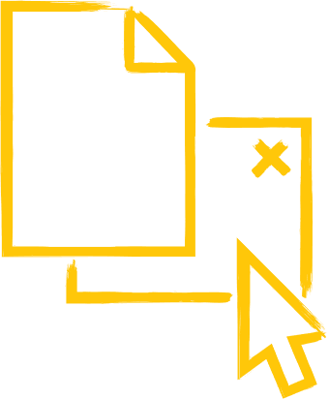

Cognitive Capture—Digitize, extract and interpret information
Paper
Email & Social
Electronic
Mobile
Ingest & understand any document and its information.
Notes:
Cognitive capture ingests and understands any document and its information, whatever channel that document is received on and whatever format the document comes in. Kofax has the most comprehensive and advanced cognitive capture capability and is the market leader.

Slide 32
















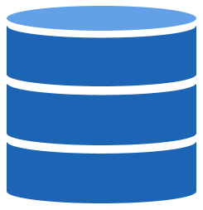
Process Orchestration: Drive workflow, exception handling and case management
Orchestrate multiple actions, people, robots, policies & systems
Information Services
Finance & Operations
Executive Management
Organization
Sales & Marketing
Process Orchestration
Adds velocity
Meets business goals
Delivers managed processes
Increases agility
Legal
Customer Service
Business Rules
Process
Content
Software Robots
Workflow
e-Sign
Analytics
Search
Communications
Monitoring
Capture
Data Management
Systems
3rd Party
ERP
CRM
ECM
Notes:
Process orchestration makes people and robots work seamlessly, to get done what neither can do alone.
And it orchestrates the systems (legacy, inhouse and 3rd party) and policies, business rules and decision engines too.
This adds velocity, removes latency, helps meet goals and delivers managed processes that allow agility.

Slide 33
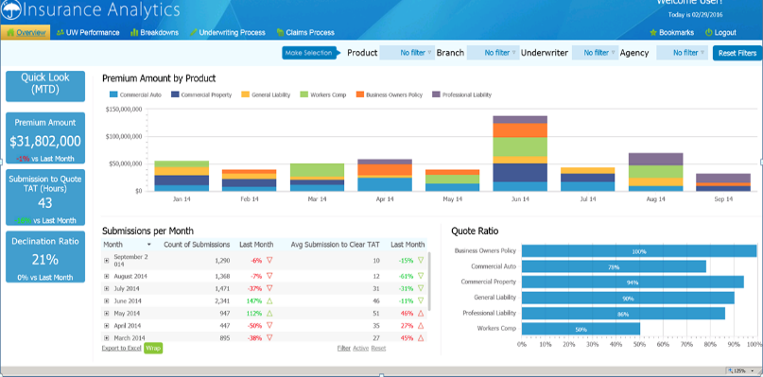
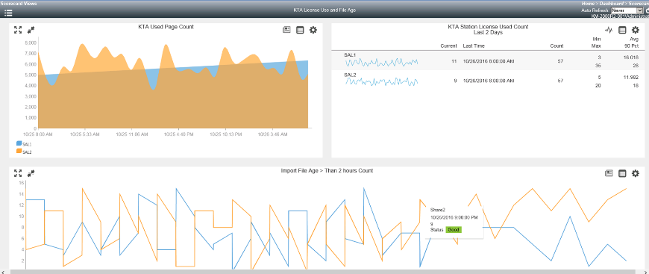
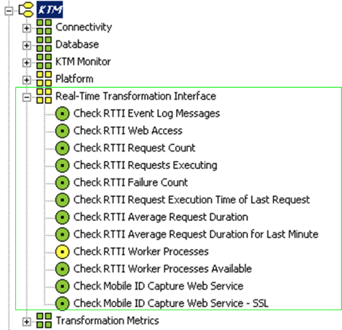
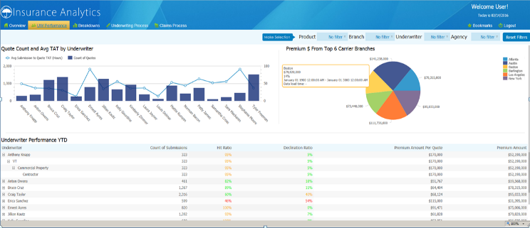
Advanced Analytics: Understand & improve process performance
Provide actionable analytics. Automate system monitoring.
Process Intelligence
System Monitoring
Notes:
Process intelligence provides actionable insights – so people and systems act smarter and faster.
System monitoring makes sure that the robotic workforce and other systems are always up and running – it even corrects issues automatically – e.g by restarting services that have gone down.

Slide 34
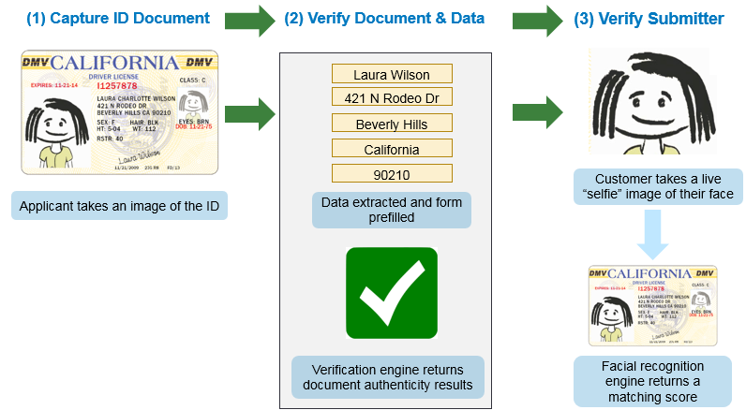
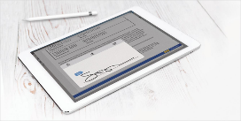
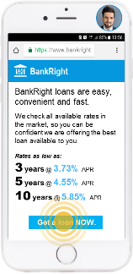
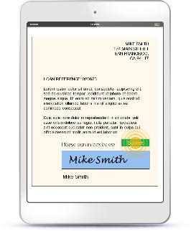
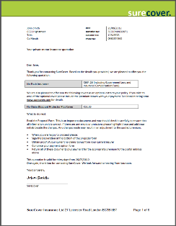
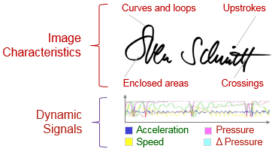

Mobility & Engagement: communicate and transact on mobile
Communicate and transact in efficient, effective and trusted ways
Verify identity with facial recognition & ID documents
Communicate messages, documents, contracts, statements
Record consent with e-signatures & biometrics
Notes:
As mobile has become the preferred channel of engagement for many customers, partners and employees, Kofax makes those mobile moments highly productive – so you can communicate and transact in efficient, effective and trusted ways.
We can verify identity, using military grade facial recognition technology and machine learning-based automatic understanding and verification of official ID documents.
We can issue multiformat and multichannel communications.
And we can gather and record consent, including through use of e-signatures and biometrics.

Slide 35

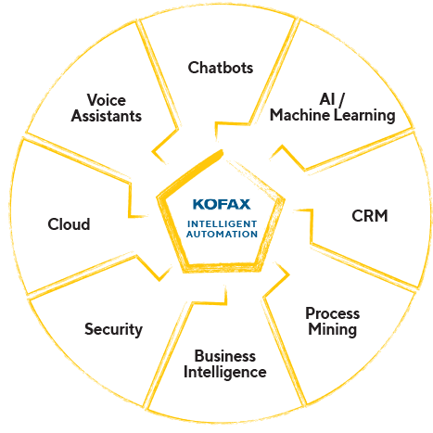





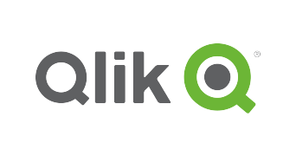

Kofax Intelligent Automation is connective tissue for digital transformation
Kofax enables convergence of the digital economy & physical world
Notes:
Working like tomorrow, means realizing the interdependent nature of today.
Kofax Intelligent Automatoin is connective tissue that advances your Digital Transformation in concert with other partners in your business ecosystem. Scaling requires this approach and Kofax leverages the ecosystem to accelerate progress. Specific names shown here are illustrative – we have a wide range of ecosystem relationships and the ability to support you in the ecosystem that matters to you.

Slide 36

…with Kofax Intelligent Automation
Transform capacity and performance
Streamline processes for efficiency & visibility
Create agile workforces, human & digital
Deliver satisfying customer experiences
Embrace diversity and innovation
Notes:
In summary, Kofax Intelligent Automation platform delivers a unified set of capabilities that together uniquely make it possible to …. [read relevant selection from the bullets]

Slide 37
Competition

Slide 38











The Competition
WEB SCRAPING VENDORS
ROBOTIC PROCESS AUTOMATION
TRADITIONAL TOOLS & DEVELOPMENT
CONNECTOR VENDORS
DATA AGREGATORS
Limited process rules handling
Multiple design tools
Web interface integration inferior to Kofax RPA
Some RPA vendors lack enterprise class functionality, rely on desktop macro recorder robots that run on the physical desktop
Rely on IT Development
Using open source web crawlers, scrapers, or scripts
Using traditional integration tools that lack capabilities for web data and apps without APIs
A real challenge in developing and maintaining the integration
Web Scraping technology is very limited one-way capability to just get/scrape some data.
Can't get all the data.
Lack enterprise class functionality
Will get you the core information – market news, financial info, BUT won’t get you the data to answer all investment questions and ideas
Connector strategy is never 100% coverage
Not a plug and play. In many cases only the vendor can code the connector to make it work, making it an expensive
Notes:
If we look at the competitive landscape, you will see there is a mix of vendors.
The first set of competitors we occasionally run into are those who focus on web data extraction. The vendors like Mozenda and Connotate are two of the more common vendors in this category.
A more common set of competitors are the robotic process automation vendors like Blue Prism, UIPath, Automation Anywhere, and OpenSpan. Competitors like Automation Anywhere will lack enterprise capabilities, and competitors like Blue Prism and OpenSpan are known for being more developer oriented products. The ability to design robots that interact with web interfaces is also inferior to the Kofax RPA web integration technology, which is a core strength to the Kofax RPA platform.
In-house IT development is also a common barrier where IT departments may object to the use of robotic automation technology and see developing the integration using traditional development platforms the preferred choice.
Other possible competitors or technology alternatives you might hear about include connector vendors like Jitterbit or SnapLogic, who pre-package the integration connectors for specific systems.

Slide 39

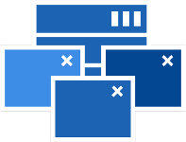


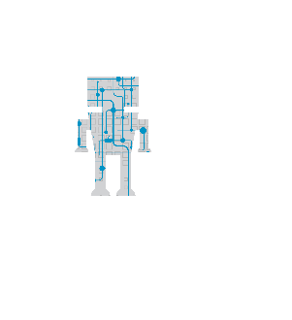





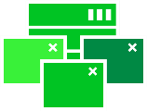

Kofax robots automate virtually any activity
Data files
JSON
Citrix
Email
Websites, Portals
Attended & Unattended Robots
Excel
Legacy systems
(AS400, Mainframe)
Digital documents
Enterprise Systems (SAP, Oracle)
Document Transformation
Databases
Notes:
Kofax RPA connects to virtually any application and data source which includes Email, Excel, Windows and Java applications, mainframe terminal applications, databases, web sites and portals.

Slide 40





Kofax robots automate virtually any application
Windows Apps
Java & Java Applets
Terminals
Image-Based Automation
Win32
.NET
Visual Basic
Internet Explorer
Swing
AWT
Oracle EBS
SAP
IBM 3270
AS400 5250
SSH/vt100 (*nix)
Citrix
Non-UI Automation
40
Notes:
Kofax RPA 10 expands the platform too deliver more value to our clients. Kofax RPA 10 will drive greater productivity within the enterprise by supporting older enterprise applications that are often difficult to integrate. These could be ERP systems from SAP and Oracle, or even an old custom built client-server application that a business still relies on heavily.
The new robotic functionality we are introducing enables organizations to truly modernize legacy systems so that those critical applications become an integrated part to the business processes vs. being an application that is disconnected from the work that employees are tasked to perform. In Kofax RPA 10, new native connectivity to mainframe terminal applications enables Kofax RPA robots to interact bi-directionally with terminal applications.
Lastly, Kofax RPA 10 builds upon our enterprise class platform, and introduces new enhanced communication and orchestration of thousands of enterprise software robots between servers, websites, portals, and remote and virtualized desktops.

Slide 41



Kofax RPA automation built on centralized server model
Robots are managed and executed on the server
Server communicates with remote desktops or virtualized machines
Easier to control and manage
Greater scalability across servers
Server
Less expensive
Notes:
A key difference with Kofax RPA an other robotic process automation offerings is how Kofax RPA deploys and runs robots. With the new application integration capabilities, robots will continue to be deployed and executed on a centralized server just like they have in previous Kofax RPA versions. The robot will run centrally and communicate with remote desktop and virtualized machine environments. The benefits to this approach is it will be easier for IT to control and manage the environment, it offers greater scalability with running robots in a clustered server environment, and this enterprise deployment model has the potential of being less expensive.

Slide 42


Kofax RPA connects to most content types without VDI
Robots execute “headless” on central Kofax RPA roboservers, instead of on Virtual Desktop Infrastructure
Web applications, cloud/SaaS applications, web portals, web sites
Excel documents, PDF documents
Mainframe / terminal applications
Data sources (SQL, etc.)
Data files (XML, JSON, etc.)
File systems

Slide 43
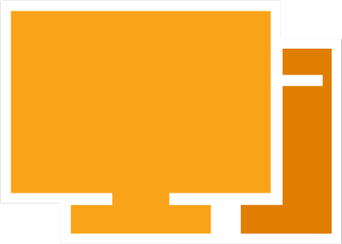

Kofax RPA has the smallest VDI footprint
VS
Server

Slide 44
Flexible usage license model vs. a per robot model
“Per-robot” licensing reduces RPA adoption after the initial projects
Cost of a “per robot” license eliminates the ROI for too many projects
With Kofax RPA you can…
Deploy as many Kofax RPA robots as you need
Design robots based on what’s best for the business…
No need to create huge, complex robots
Automate many
more processes, because ROI is achievable with
Kofax RPA

Slide 45
What’s different about Kofax RPA?
#1
One design tool for dev and test – no coding
#2
The most advanced web-based robotics
#3
Smallest VDI footprint – dynamic bot provisoning
#4
Dynamic license utilization and unlimited robots
#5
The most advanced cognitive capabilities
* Kofax cognitive capabilities require additional licensed module separate from Kofax RPA RPA
Notes:
No coding design environment for the business analyst, but powerful enough for the developer - Build bi-directional robotic automation flows, transform and enrich data, and apply business logic all without writing a single line of code. Kofax RPA Design Studio is unlike like macro recording tools like Automation Anywhere that limit designers on what they can do, and not a complex development environment like the OpenSpan product.
Server architecture and centralized robot execution enables concurrent running of robots, superior performance and scalability - Unlike all RPA competitors, Kofax RPA centralizes the deployment, execution, and management of robots on the server. Competitors like Automation Anywhere, Blue Prism, OpenSpan, and others all package and run their robots on the desktop or virtualized machine. This creates a nightmare with deploying and maintaining potentially hundreds if not thousands of robots across desktops and virtualized environments. Multiple Kofax RPA robots can be executed from a single server or assigned to a specific server in a clustered environment providing greater scalability and performance than deploying robots to desktops.
Superior web-based application automation with integrated web browser engine - Kofax RPA is the only RPA vendor who has built a robot design environment that integrates a browser engine. Multiple Kofax RPA robots that are interacting with a web source (web site, portal, or application) can be run concurrently on a single server. RPA competitors require a browser like Internet Explorer to execute a robot which means only one robot can run on a server or desktop at one time given it takes full control of the browser.
>>> Our customers tell us there is nobody else in RPA that allows you to build robots for web-based systems and web-based content as fast, as easy, or as powerful as you can with Kofax RPA.
Flexible usage license model vs. a per robot model - Kofax RPA Usage Model has many benefits which include allowing our customers to design and deploy as many robots as they would like. “Per robot” models from competitors like Blue Prism limits the number of robots you can design and run forcing customers to continuously come back and buy more “robot” licenses. This model typically slows RPA adoption beyond initial project, across the enterprise. Cost of a “per robot” license does not always align to the customer value.

Slide 46

Why Kofax?
The Paperless Experts
Lowest Desktop Footprint.
Enterprise Scalability. 30,000 robots
Citrix Control
Web Robotics
Single Provider or
Intelligent Document Recognition with Machine Learning
Document Capture, Process Intelligence/Analytics, BPM, Dynamic Case Management, Mobile, Document Signing, Customer Communication Management
Kofax RPA Runs on Tomcat, so you can leverage any Apache utilities
No Coding
Cognitive Capture is Kofax’ own technology & core business for 15+ yrs.
Intelligent Automation Platform

Slide 47
Kofax RPA delivers better business results
The Kofax RPA Difference
Business Benefit
Interactive, no code
design experience
Accelerate
business transformation
Centralized robot execution
& unique server architecture
Lower cost per automation
and increase scalability
Superior automation
for web-based applications
Create business leverage
for enabling large-scale operations
Advanced analytics
for RPA operations and performance
Enable crucial visibility
for maintaining optimal performance
Flexible usage
license model
Deliver best economic value
and total cost of ownership (TCO)
Notes:
Summary of what we just covered.

Slide 48


Robot Ethics
Respect websites and humans
Tread lightly
Don’t steal
Notes:
Act ethically. If your robots act like humans on the websites you are interacting with, you should have little problem with the web site owners.

Slide 49
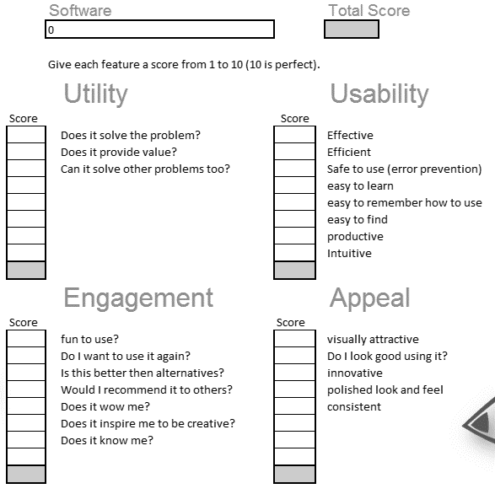
4 Aspects of User Experience
Utility
Usability
Engagement
Appeal
Notes:
How would you score the Champagne Solutions you have seen?

Slide 50
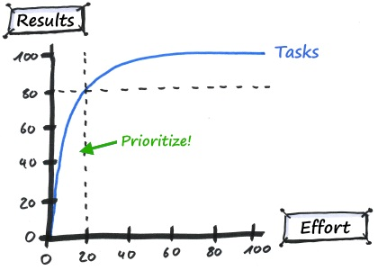
Pareto Principle
80/20 rule
96%/4%
99.8%/0.2%
Notes:
Break problem down.
Goal is always to reduce human effort.

Slide 51
Software acquisitions to complete the Kofax Vision
1985 – Founded as Dicom in Switzerland as a Samsung distributor; Expanded into imaging hardware and maintenance services via 15 EMEA acquisitions
Began implementing new strategic initiatives
Acquired 170 Systems
Acquired Atalasoft
Acquired Altosoft
Acquired Softpro
Acquired Aia
Lexmark announced sale to a consortium led by Apex
Kofax
Acquires
Nuance Imaging
Greg Lock joined as Chairman
Reynolds Bish joined as CEO
Acquired OptiInvoice
Acquired Singularity
Acquired Kofax RPA
Lexmark acquired Kofax; changed leadership of Enterprise Software Business
Thoma Bravo acquired Kofax
Kofax
Acquires
Top Image Systems
1985-2007
2007
2008
2009
2010
2011
2012
2013
2014
2015
2016
2017
2018
2019
1996 – Went Public on AIM and then LSE
1999 – Acquired Kofax in Irvine to expand into the Capture business, which it then grew through four acquisitions
Transitioned to US $ reporting
Disposed of legacy VAD systems
US financial expert joined Board
Dual listed on NASDAQ
Lexmark announced it’s exploring “strategic alternatives”
Consortium closed on the acquisition of Lexmark and changes hardware business leadership

